Slide 1
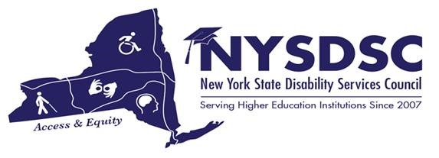
Spring 2022 NYSDSC Conference Reader’s Aid Funding
Tamara Mariotti, Coordinator of the Office of Accessibility Resources (OAR), Mohawk Valley Community College

Slide 2
Reader’s Aid Funds
The amended Reader’s Aid legislation (A06515A) became law on October 23, 2017. Reader’s aid amendments for expansion of it’s funding went into effect January 2018 up to $4000.00per student/ per year.
The language to expand the disability eligibility from legally blind or deaf, to include print disability has required additional work. NYSDSC has been working with NYSED to understand the numbers of Print disability.

Slide 3
What is the Readers Aid Program
The Readers Aid Program provides funding each academic year to participating institutions of Higher Education to help to meet the costs of note-taker, reader and/or interpreter services. Funding requests are coordinated and paid through the institution of Higher Education.
Assistive technology is covered for the eligible students (One time cost)
(Readers Aid Program funds cannot be used for tuition, maintenance fees, tutoring, guide services, or textbooks.)
Up to 4000.00 per year, 2000.00 per semester.

Slide 4
Eligibility
Eligibility:
Students with hearing loss (70dB or more);
Legally blind (meaning 20/200 vision);
NY State resident;
Matriculated for a certificate or degree in higher education.

Slide 5
Application process
http://nysdsc.wildapricot.org/news
Must apply by Nov 1 – Fall Semester, March 1, for Spring Semester, July 1 for summer
Applications completed one time per year per student with original signature.
College is required to complete two forms which are available at the link above.

Slide 6
Questions about the Readers Aid Program
Donald McManus New York State Education Department Office of Adult Career and Continuing Education Services –Vocational Rehabilitation
89 Washington Avenue, Room 580 EBA Albany, NY 12234 Phone: (518) 473-1626 Email: Donald.McManus@nysed.gov

Slide 7
Thank you
Tamara Mariotti – tmariotti@mvcc.edu

