Slide 1
Art Therapy for Self-Care
An Introduction and Experiential for Disability Professionals in Higher Education
Emi DiSciullo, MS, LCAT
SUNY New Paltz

Slide 2
Agenda
Introductions
What is Art Therapy?
How can Art Therapy benefit students in a DRC setting?
Art Experiential
Q&A

Slide 3
Introductions
Introduce yourself with a drawing of something that begins with the first letter of your name.

Slide 4
What is Art Therapy?
THE AMERICAN ART THERAPY ASSOCIATION (AATA) definition:
Art therapy is an integrative mental health and human services profession that enriches the lives of individuals, families, and communities through active art-making, creative process, applied psychological theory, and human experience within a psychotherapeutic relationship.
.
Art therapy, facilitated by a professional art therapist, effectively supports personal and relational treatment goals as well as community concerns. Art therapy is used to improve cognitive and sensorimotor functions, foster self-esteem and self-awareness, cultivate emotional resilience, promote insight, enhance social skills, reduce and resolve conflicts and distress, and advance societal and ecological change.

Slide 5
SUNY New Paltz Programs Offered
Benefits of Art Therapy
-Connecting with others & improved empathy
-Development of communication skills -Self-expression & awareness
-Self-regulation/ Development of coping skills
-Creative exploration of ideas
-Improve self-esteem
-Personal Growth Topics Explored
-Identity
-Self-Image
-Stress management
-Inclusivity
-Social issues
Open studio art groups
Topic based artmaking
Eco Art Excursions
Museum Field trips

Slide 6
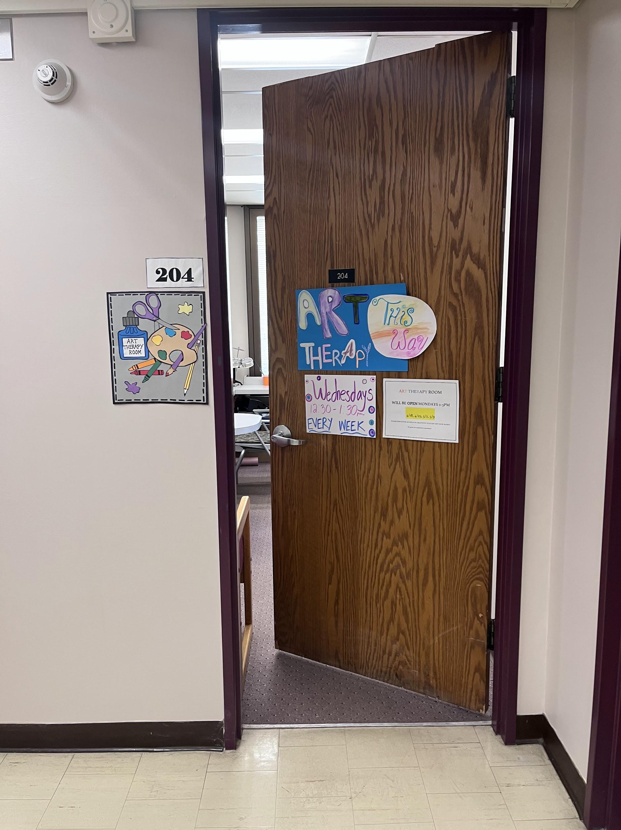
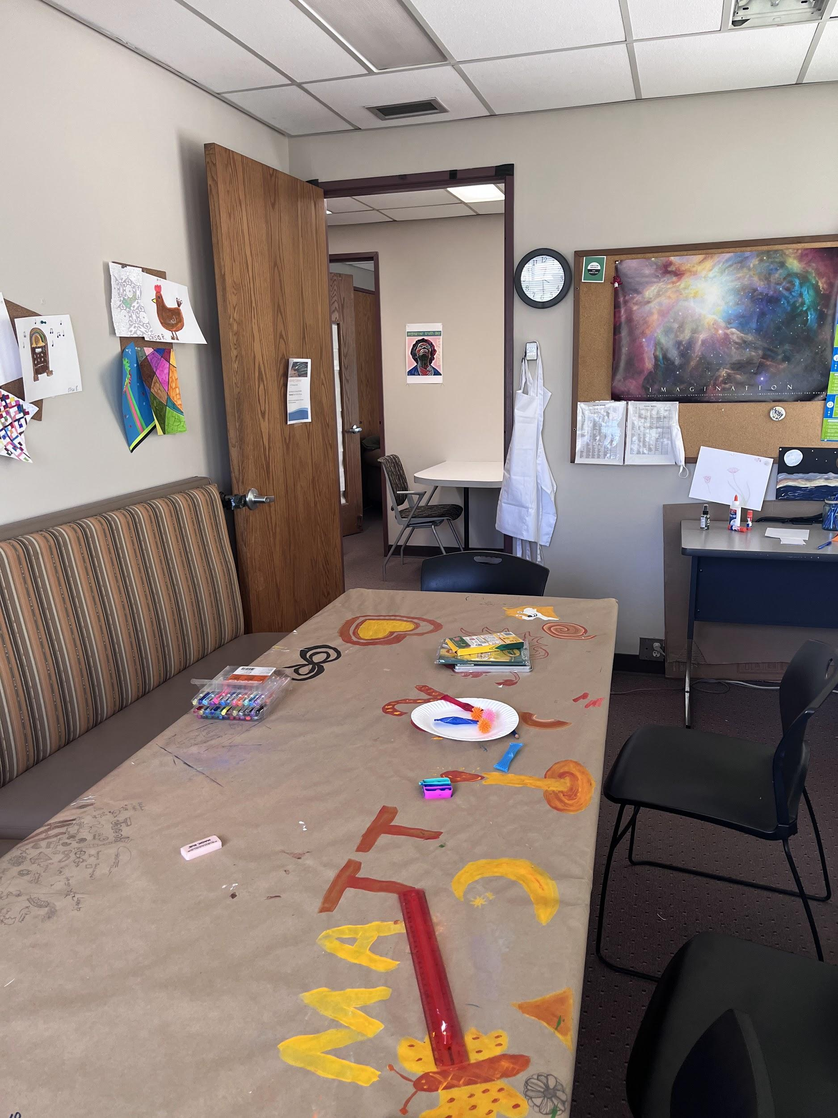
Art Therapy Room Photos

Slide 7
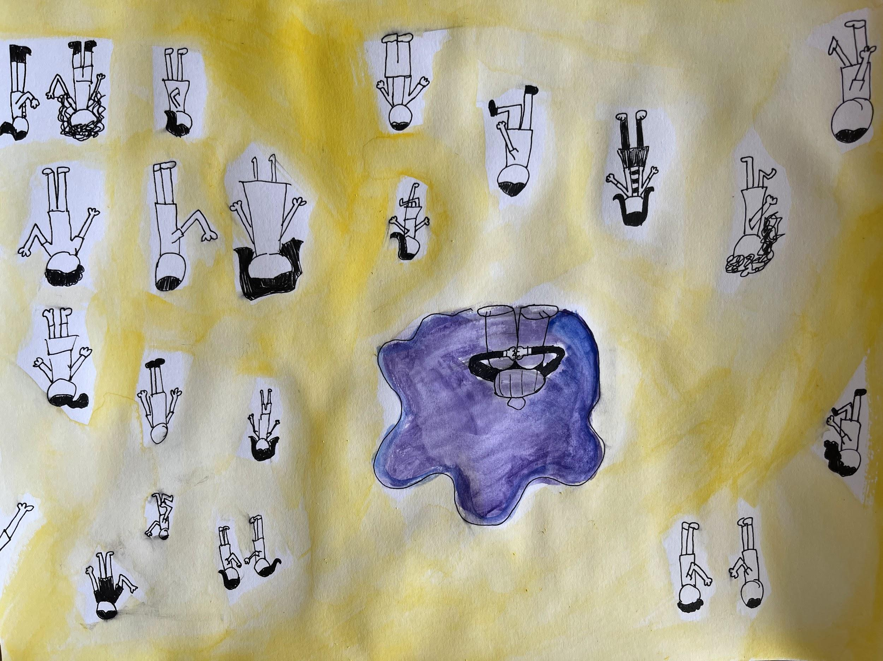
Student Artwork

Slide 8
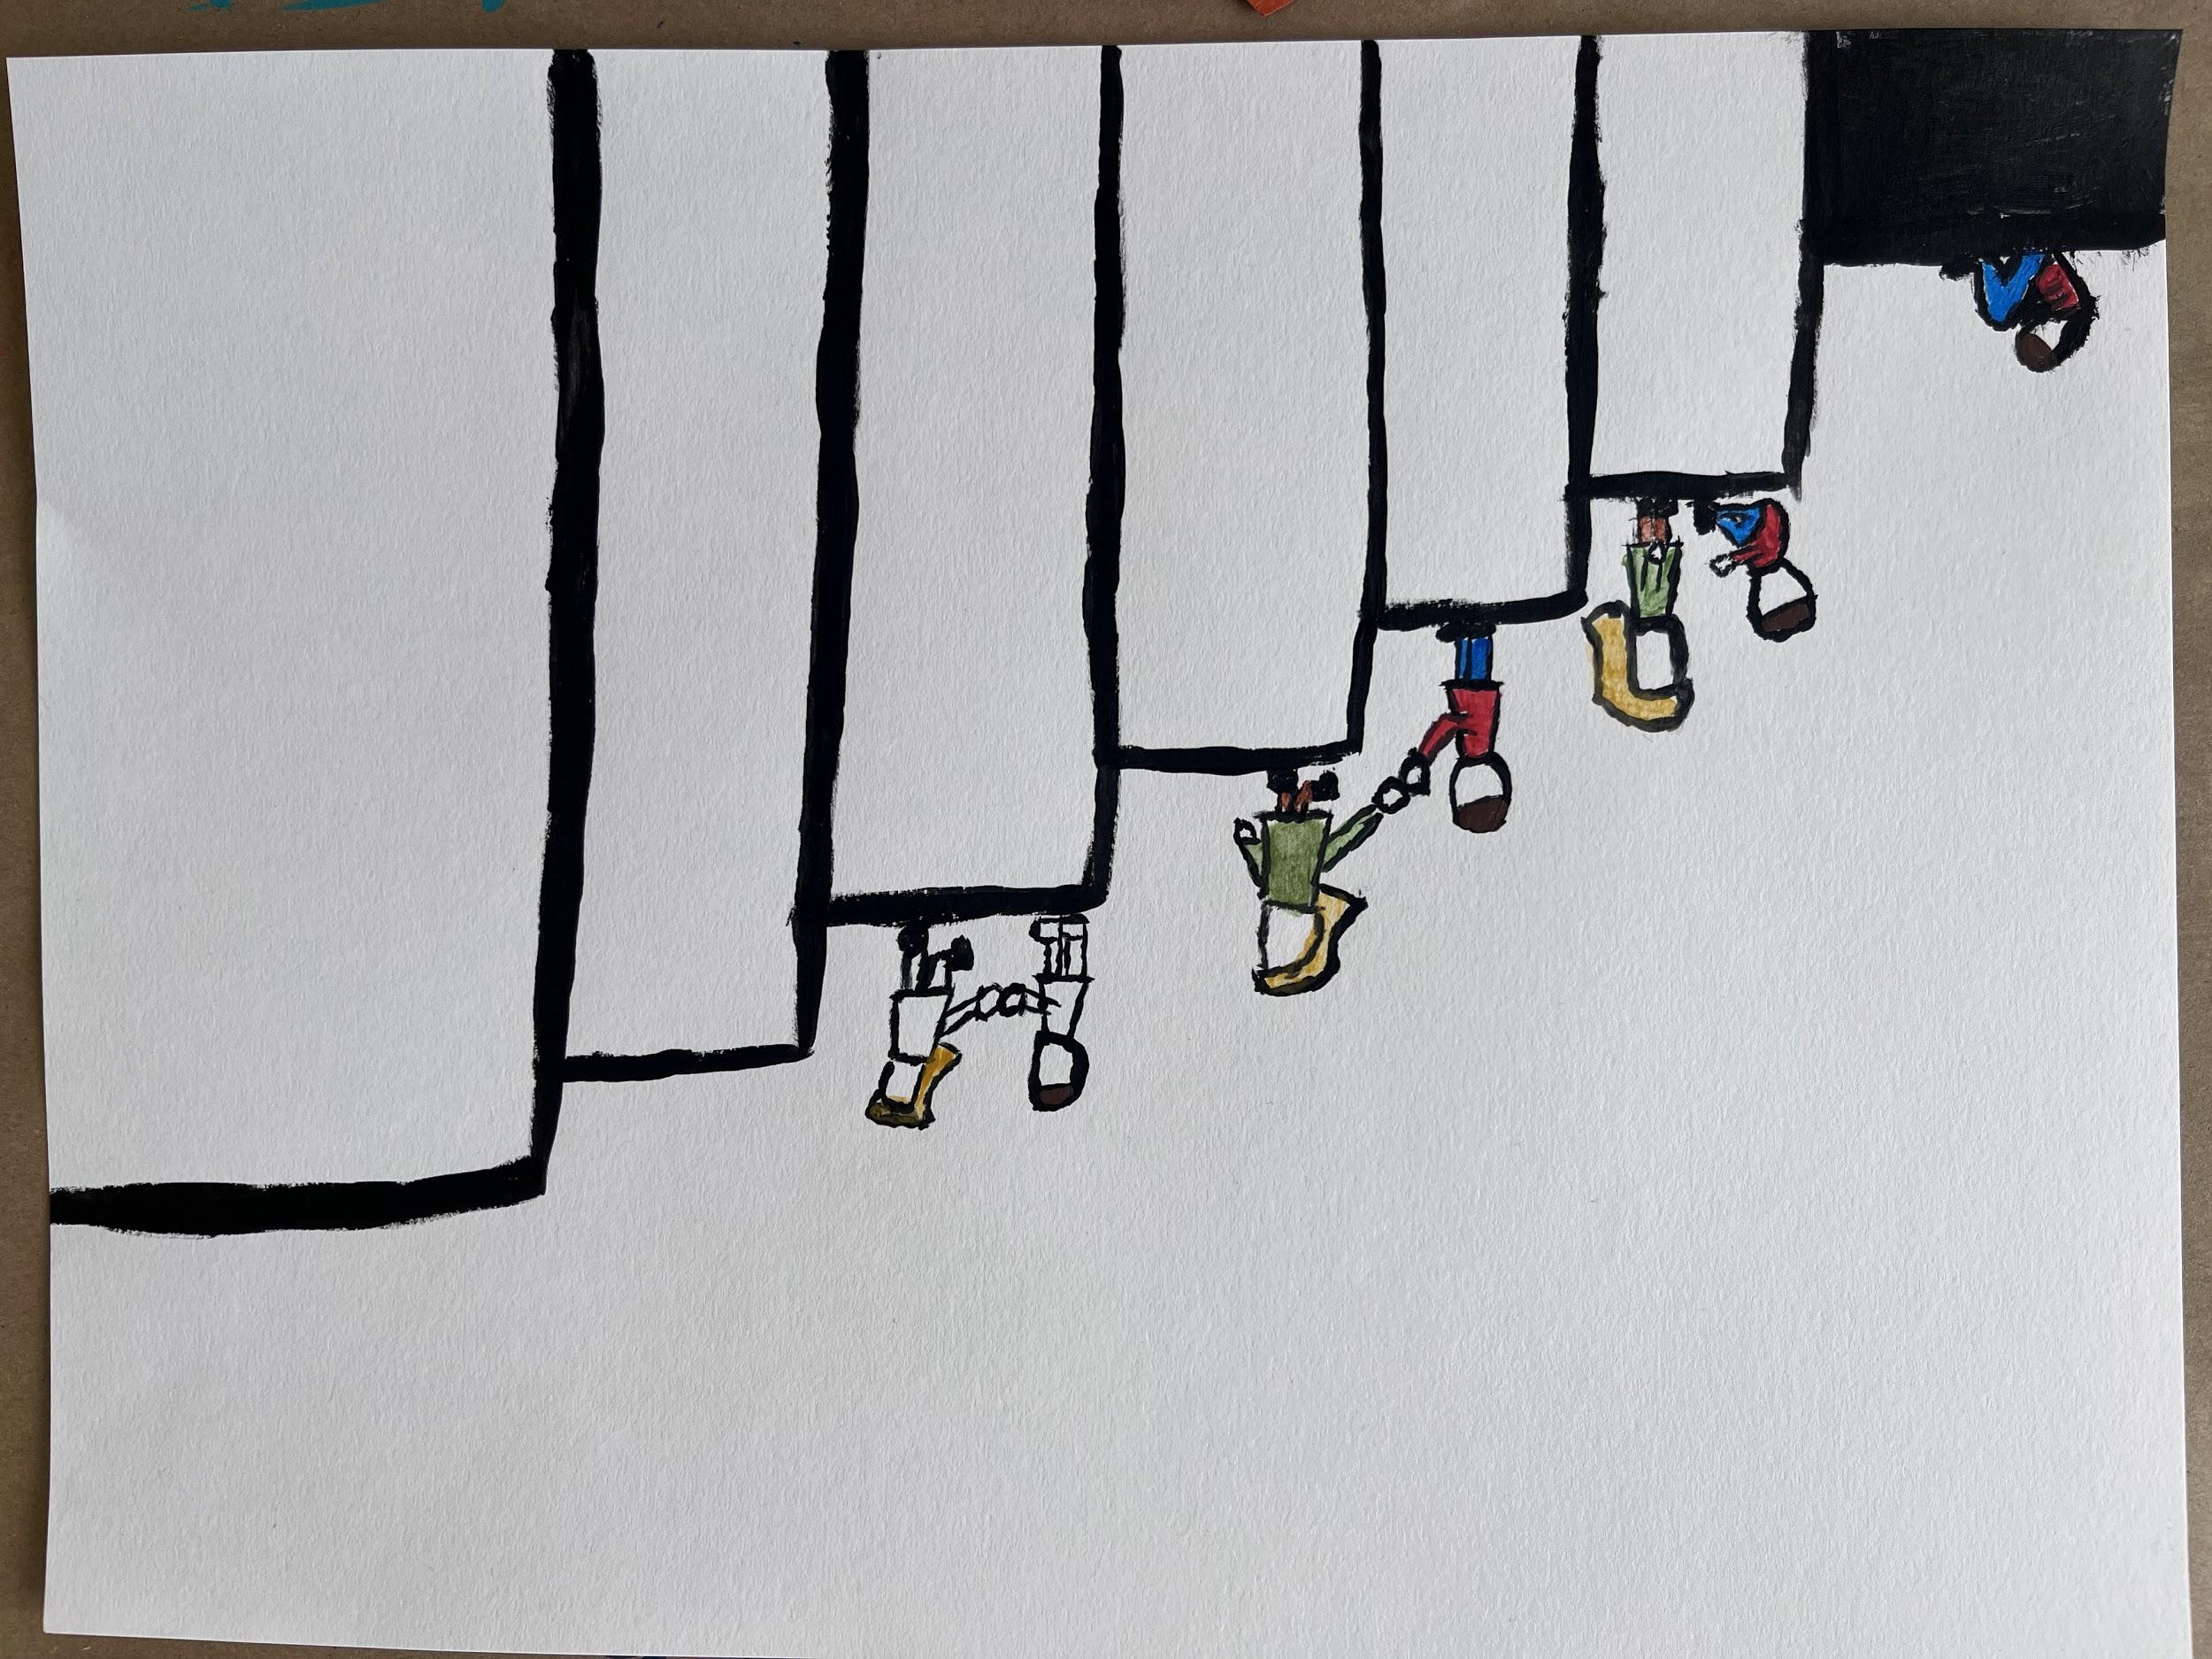
Student Artwork

Slide 9
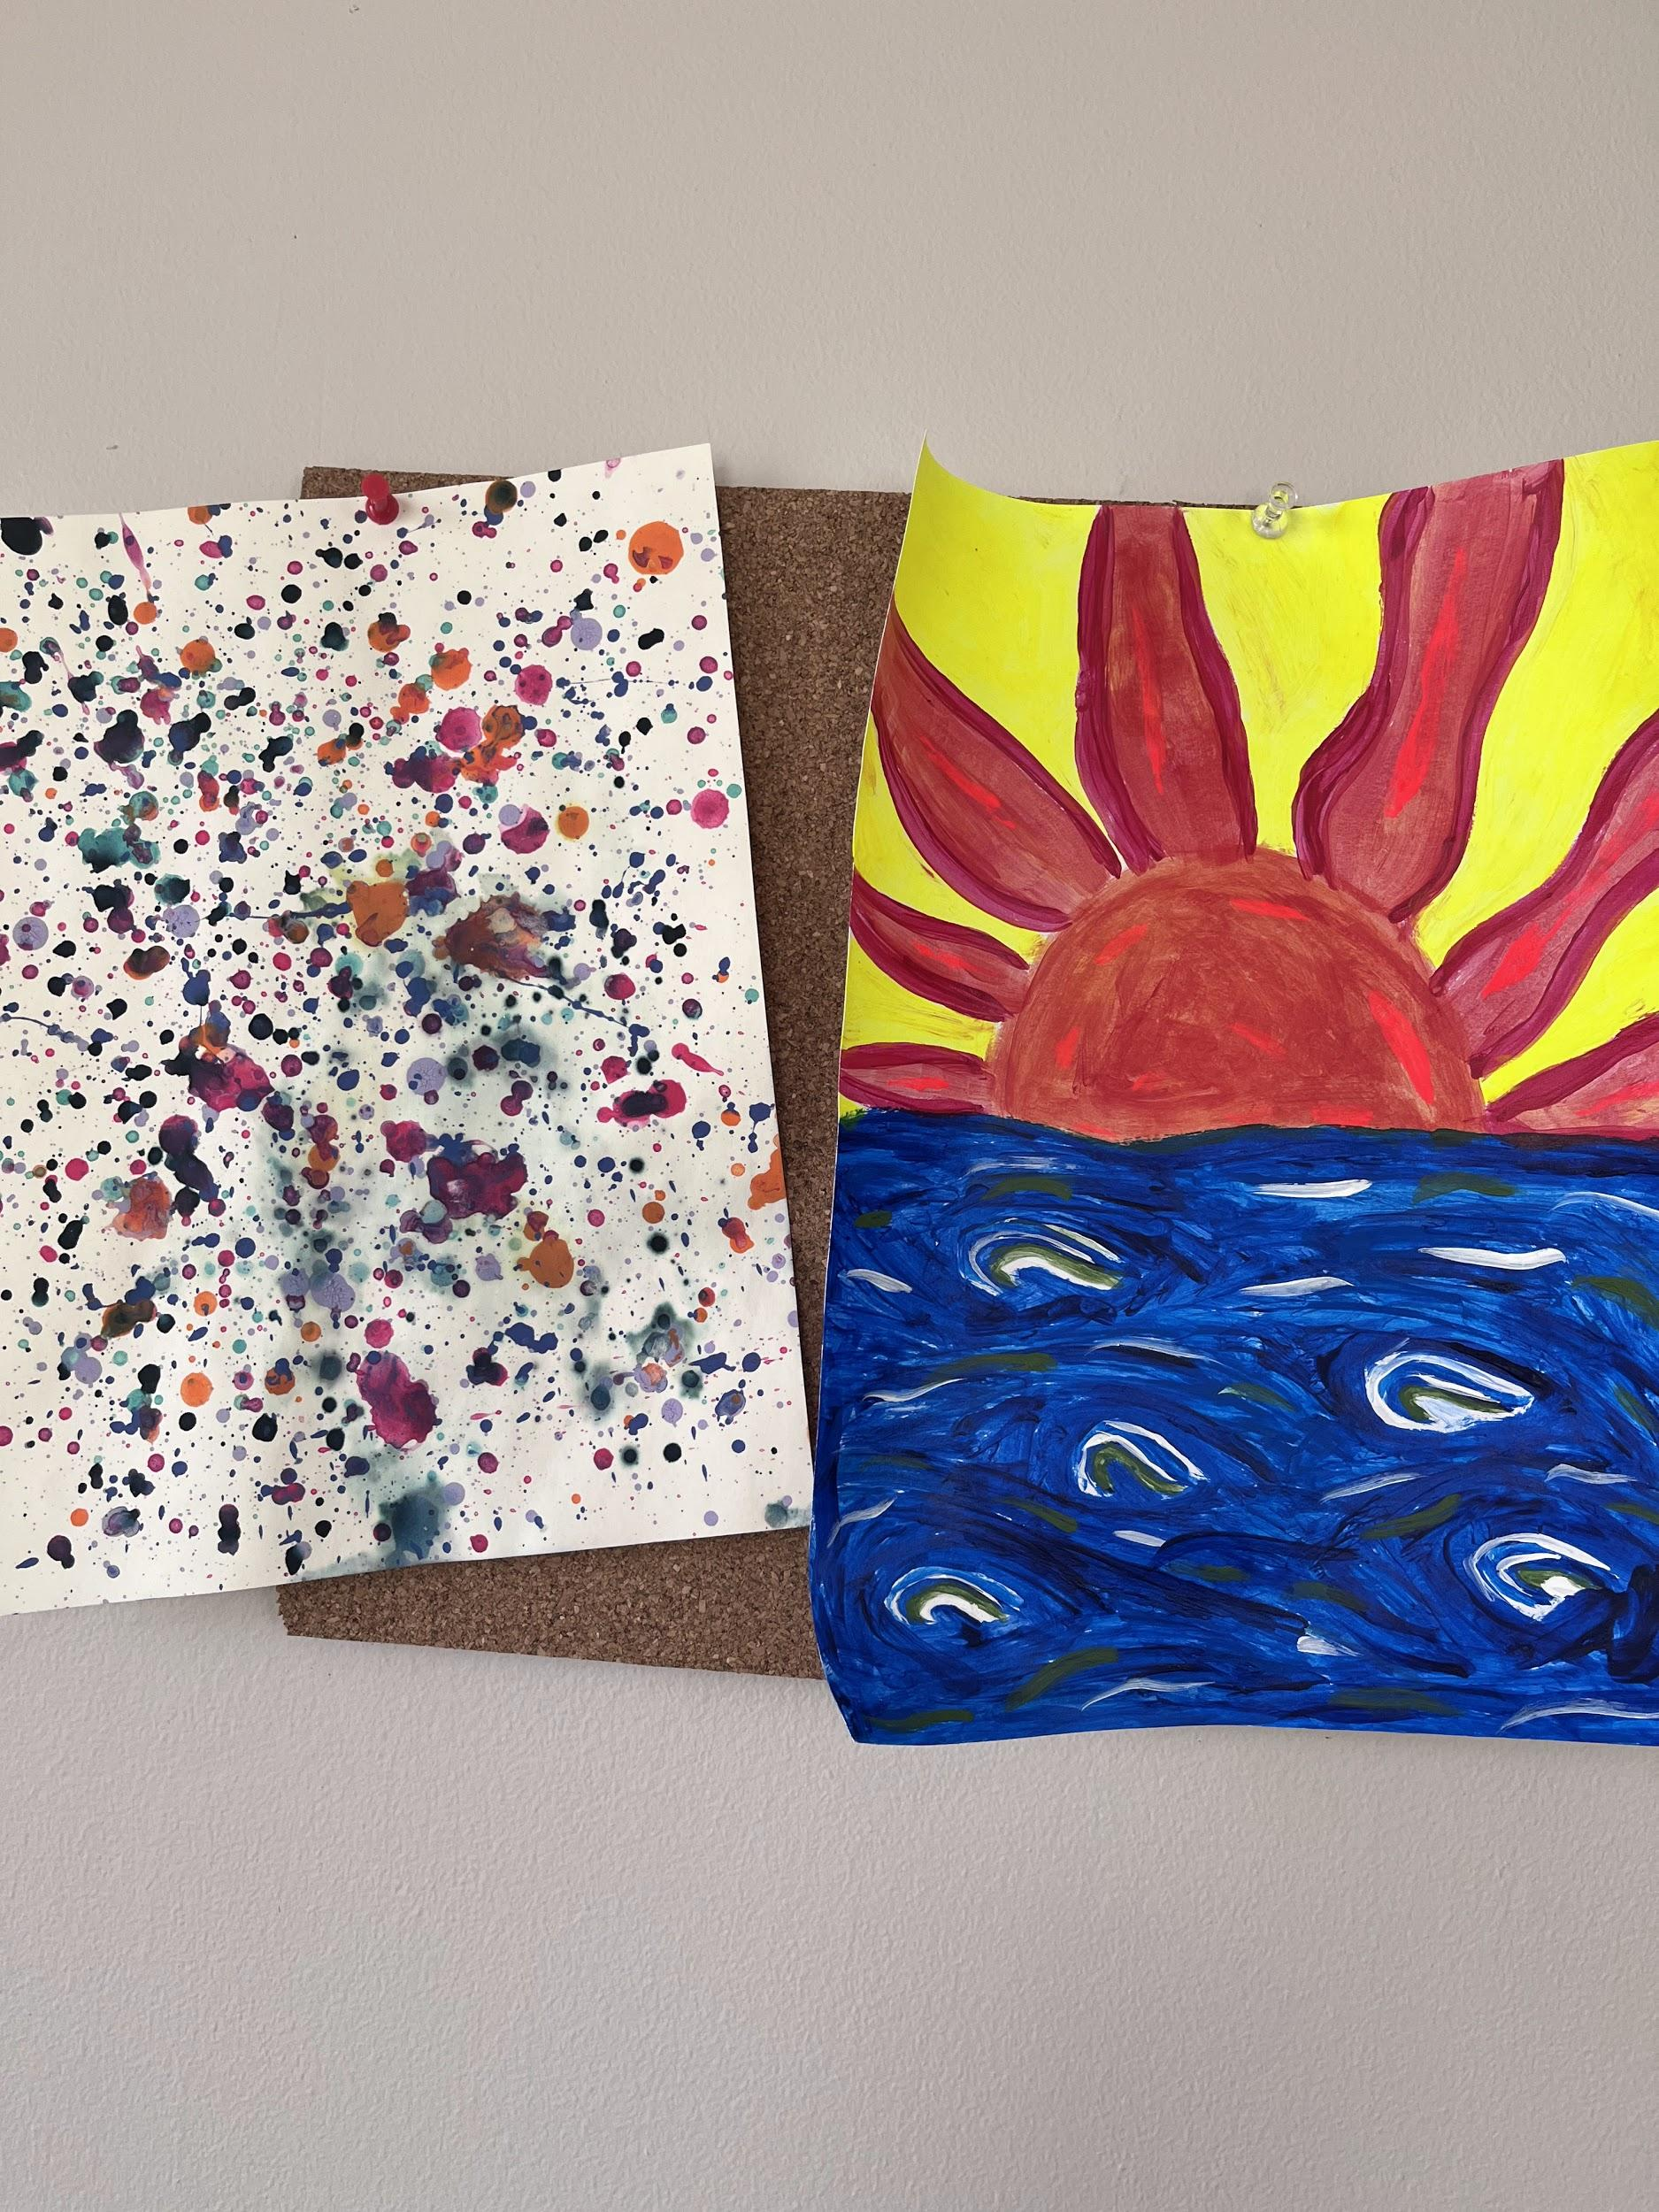
Student artwork

Slide 10
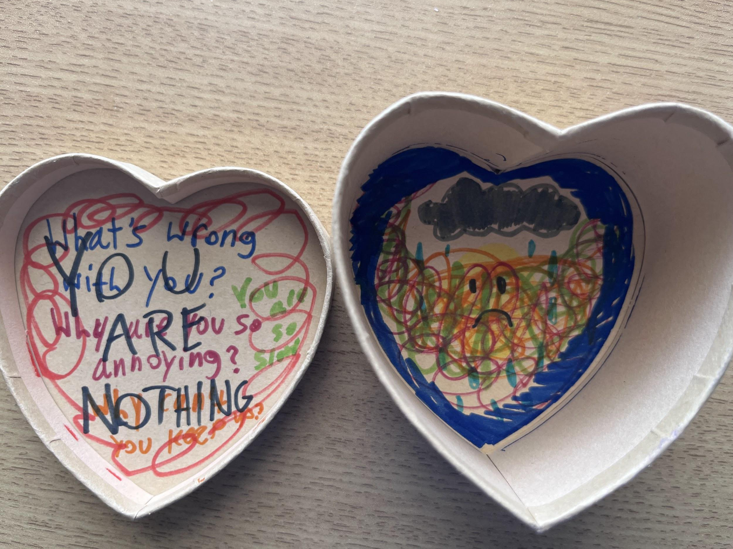
Student Artwork

Slide 11
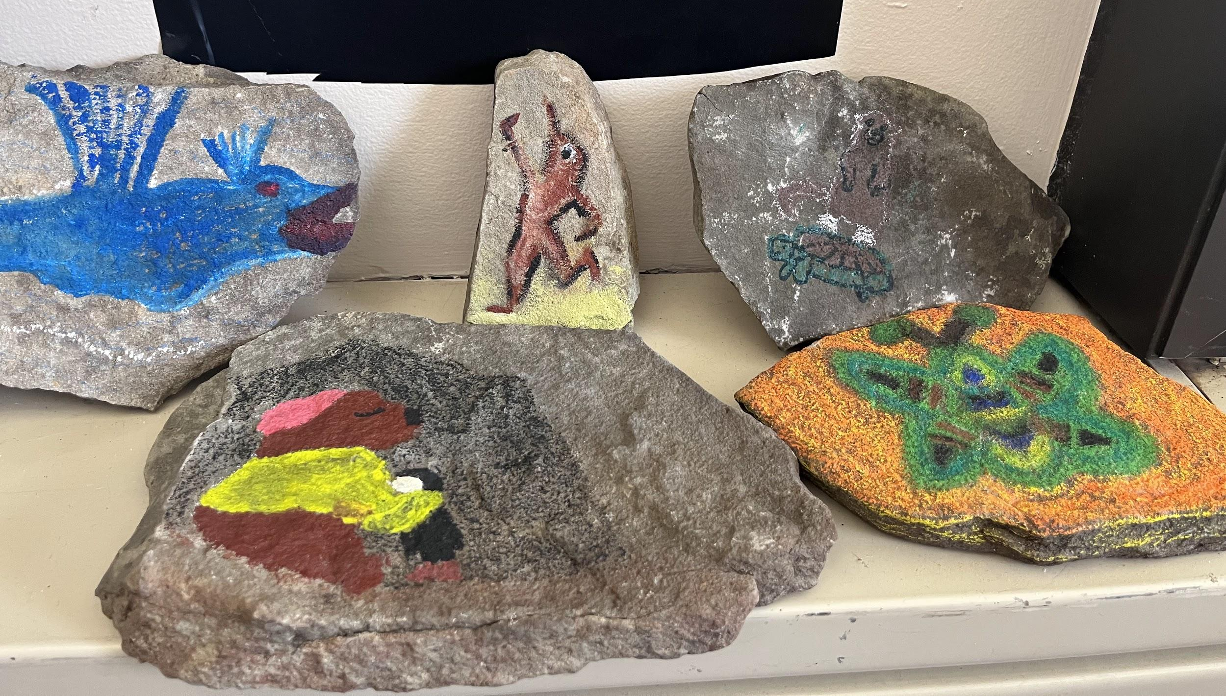
Oracle Highlight
“I picked the dolphin because dolphins have shown signs of human-like intelligence, and I highly value my capacity to reason. But I also long for the freedom of movement that dolphins must have, being able to maneuver agilely through the water. I’m not exactly athletic, and I struggle with time management, so I always feel like I’m stumbling through both space and time.”
“To show the dolphin is me, I added my signature hairstyle. I thought it’d be funny to make it look like I’d abruptly transformed into a dolphin, so I did my best to show the sleeves of my sweatshirt dangling off the flippers and the tail coming out one pant leg.”
“The freedom from my current physical and societal constraints is what the dolphin form represents to me,” Contzius said.

Slide 12
Art Experiential
Considerations when processing the activity:
-How do you handle the unexpected?
-What was it like surrendering your scribble to someone else?
-How does perception play a role in how we see things?
-Do you see any parallels to how your approach life?
Scribble Drawings
Create a free scribble
Trade with a partner
Create an image using the scribble

Slide 13
THANK YOU!
Questions?
Emi DiSciullo, MS, LCAT, ATR-BC
SUNY New Paltz, Disability Resource Center
disciule@newpaltz.edu

